Slide 1
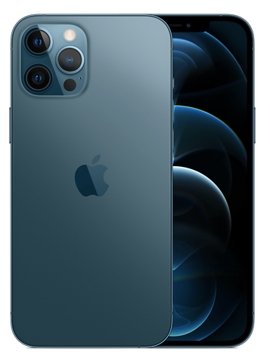



Final Project Gesture Recognition
Multi-media SoC Design
Group 15
R08943127 張立昇
R08943164 蕭育任
R09943008 陳祈瑋
GitHub link:
https://github.com/ciwade870307/Adaptive-CNN-ELM
Notes:
大家好 我們是第15組
今天我們要報告的是實作image histogram equalization的project

Slide 2




Motivation
Sign Language is a major way that the hearing-impaired used to communicate with others
However a majority of people haven’t learned sign language which make the conversation a difficult thing for a hearing-impaired
Writing down words or showing words on mobiles may be good ideas, but most of time they make conversation a long process
Can we find a new way to change this situation?
Notes:
(Max)
應用於喑啞人士 從一個大的系統(手語)逐漸限縮至字母辨識
把proposal搬過來

Slide 3
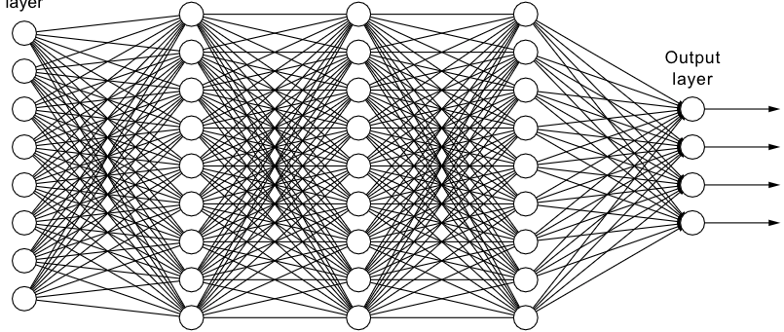

Prior Works and Challenge
Convolutional Neural Network (CNN) is a common solution in computer vision however
It leads to extremely heavy burden for local devices
Although there are many improvement ways, it’s still not a good choice for recognition task on a device
Training NN on device is a hard mission, so we can not easily make NN system adapt to an user once it’s deployed on the device
Notes:
(???)
傳統作分類的model與其缺點(模型過大，無法re-train等等)
可以再加上CNN的圖說明

Slide 4
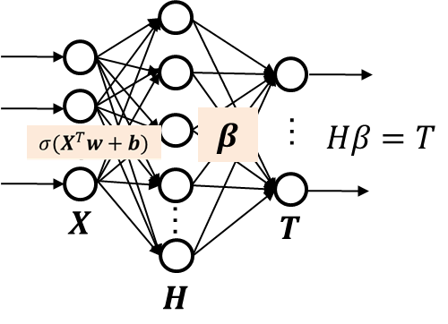

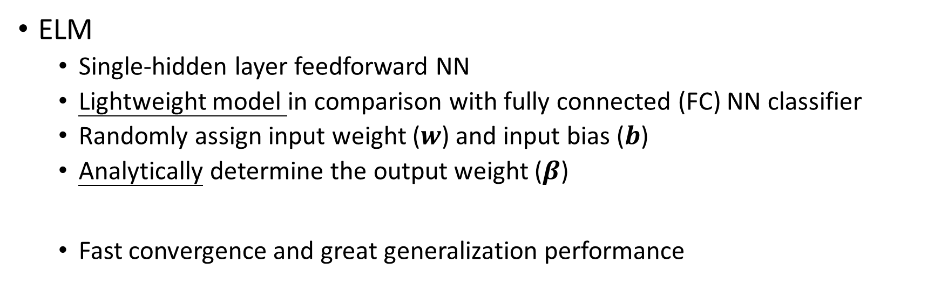

Extreme Learning Machine (ELM)
ELM
Single-hidden layer feedforward NN
Lightweight model in comparison with fully connected (FC) NN classifier
Randomly assign input weight ($w$) and input bias ($b$)
Analytically determine the output weight ($β$)
Fast convergence and great generalization performance
$$β=H^{†}T={(H^{T}H)}^{−1}H^{T}T$$
Consider advantages of ELM as mentioned,
We replace FC layers with ELM to exploit retraining capability
Notes:
(Fatty)
簡單介紹ELM
分析相較於CNN的優點(train or inference上的參數量計算量等等)

Slide 5
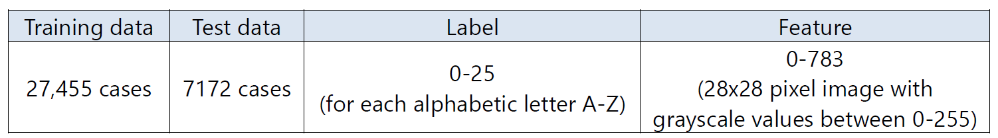
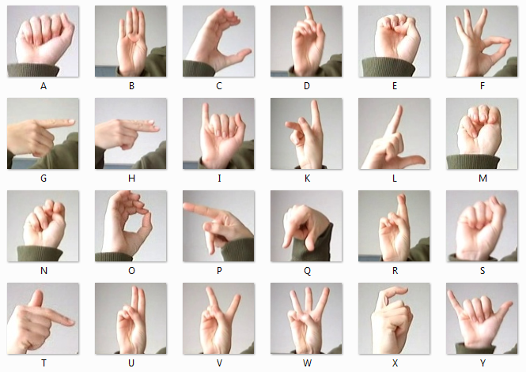
Dataset: Sign Language MNIST
Training data | Testing data | Label | Feature dim.
27455 cases | 7172 cases | 0 – 23 (for each alphabetic letter A - Z) (except for J and Z) | 0-783 (28*28 pixel images with grayscale values between 0 - 255)
https://www.kaggle.com/datamunge/sign-language-mnist
Preprocessing techniques:
Zero-padding to 32*32
Random rotation (degree -15 to 15) for training generalization
Normalize each pixel to range [-1, 1]

Slide 6




Proposed Model: Adaptive-CNN-ELM
Use weight-frozen convolutional architecture as feature extractor
Use extreme learning machine(ELM) as classifier which can be adjusted based on the user’s physical habits
We expect that adaptation on ELM can lead the model more customized for the hearing impaired user depending on personal bias of hand gestures
ELM
Convolution-based
Feature extractor
A ~ Z
…
…
$$X$$
…
$$T$$
$$H$$
Notes:
(Max)
CNN for feature extraction
ELM for adaptation
預期的結果與優缺點分析

Slide 7
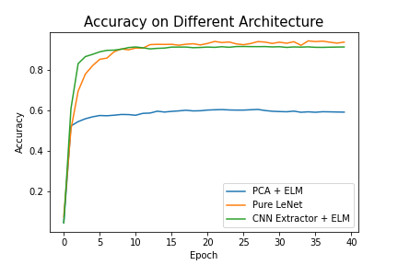
Software Result
Unbalanced label experiment
Reduce data of certain classes (W, X, Y letters)
Use ELM to retrain these data on device and analyze the result
Original result
Experiment result
Average acc=0.9245
Average acc=0.8875
Average acc=0.9207
Notes:
(Max)
收斂圖
Unbalance retrain後的結果

Slide 8






System Diagram
Two mode
Re-training / Inference
Weights of Conv
Bias of Conv
Feature Extractor
ELM inference
Output Probability
Input Features
$$W_{conv}$$
ReLU
ReLU
ReLU
Maxpool1
Maxpool2
Conv1
Conv2
Conv3
$$b_{conv}$$
FC
FC
ELM training
$$W_{elm}$$
$$b_{elm}$$
$$β_{elm}$$
$$β_{elm}$$
BS
QRD
Weights of ELM
Bias of ELM
Beta of ELM
Ref: https://github.com/changwoolee/lenet5_hls
Notes:
(Wilbur)
畫硬體架構圖，並用簡單動畫介紹mode、data flow

Slide 9
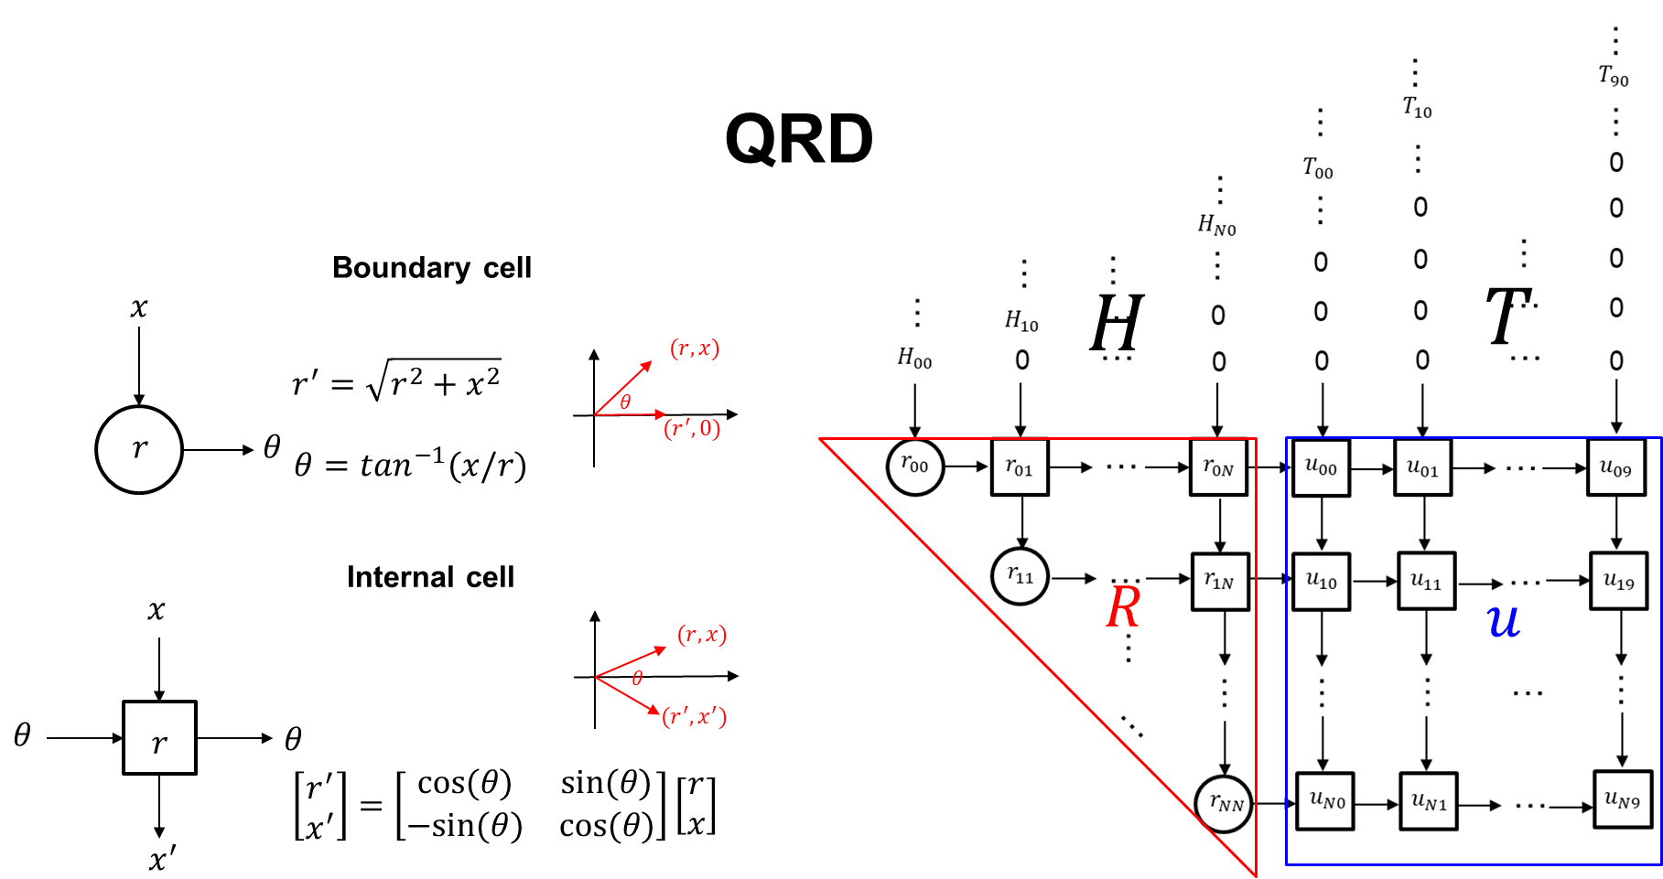
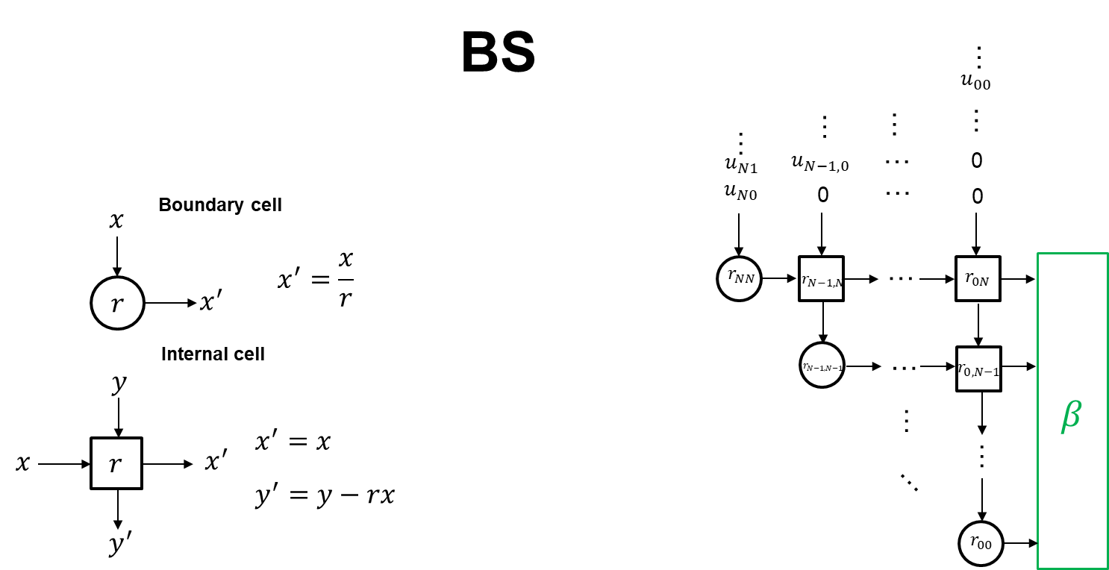
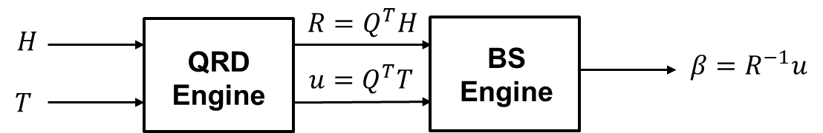

Improvement – Training (1/3)
Due to matrix inverse in ELM is not hardware friendly
High computational complexity: $O(n^{3})$
Proposed QRD-RLS based ELM
Hardware friendly version of ELM
Implementation with systolic array
High parallelism
Avoid high complexity matrix inverse calculation
Method
QRD: QR decomposition
BS: Back-substitution
Notes:
(Fatty)
Inverse matrix在硬體難以實現, so introduce to QRD

Slide 10
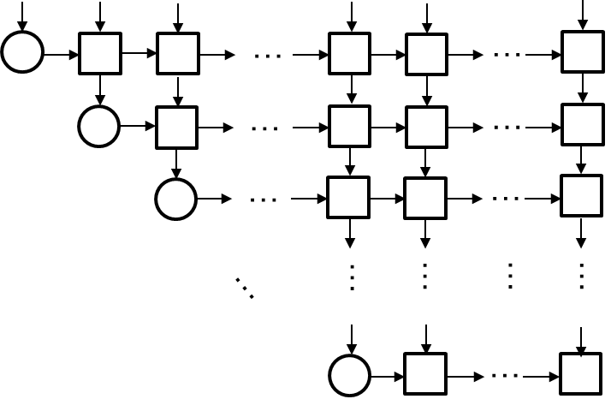
Improvement – Training (2/3)
Use folding method to reduce # of used cell
 | Original Array | Folded Array
# of PEs | 18564 | 2

Slide 11
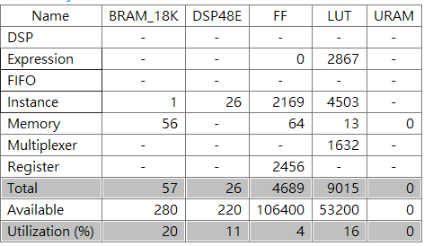
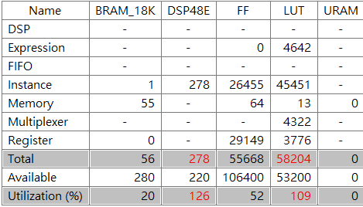
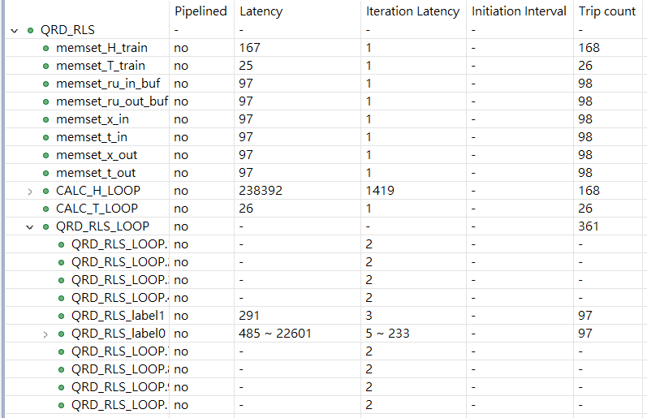
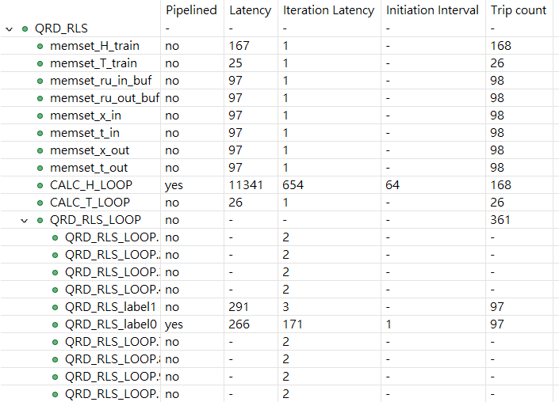
Improvement – Training (3/3)
Original
Pipeline

Slide 12
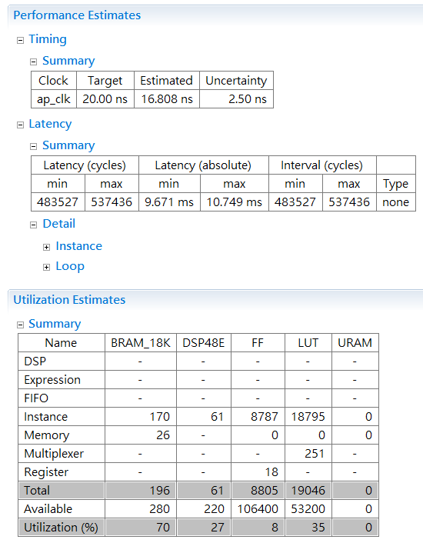
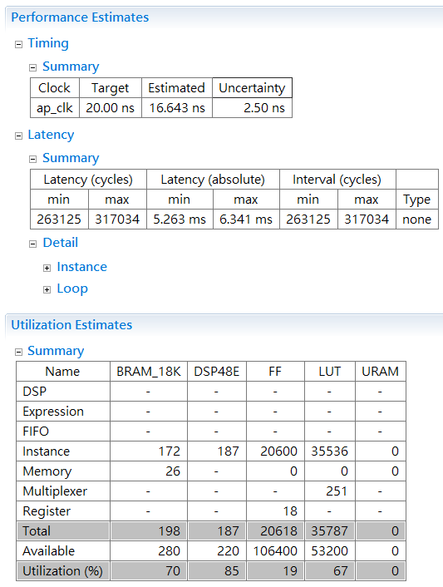
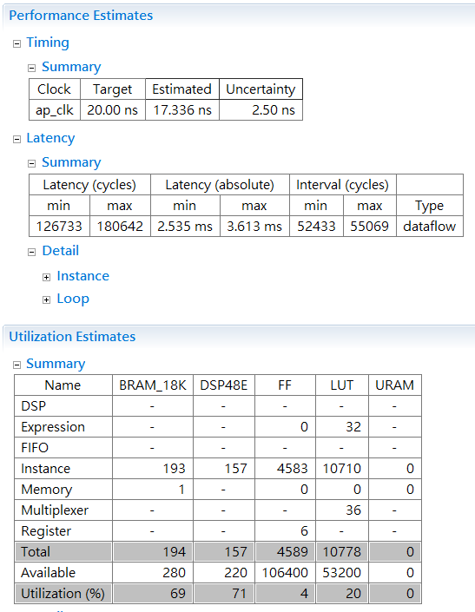
Improvement - Inference
Goal: High throughput
Pipeline: Basic strategy to reduce the latency
Unrolling: Reduce ~2x latency but higher resource utilization
Fixed point: Reduce both on latency and resource utilization
Pipeline
Unrolling
Fixed point
Notes:
(Wilbur)
If there is any improvements from pragmas (Maybe shown in final ppt)

Slide 13
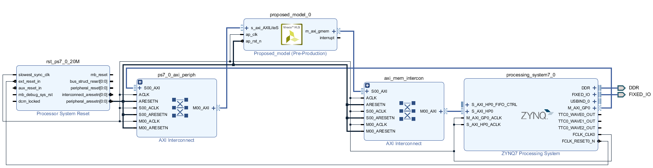

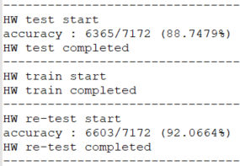

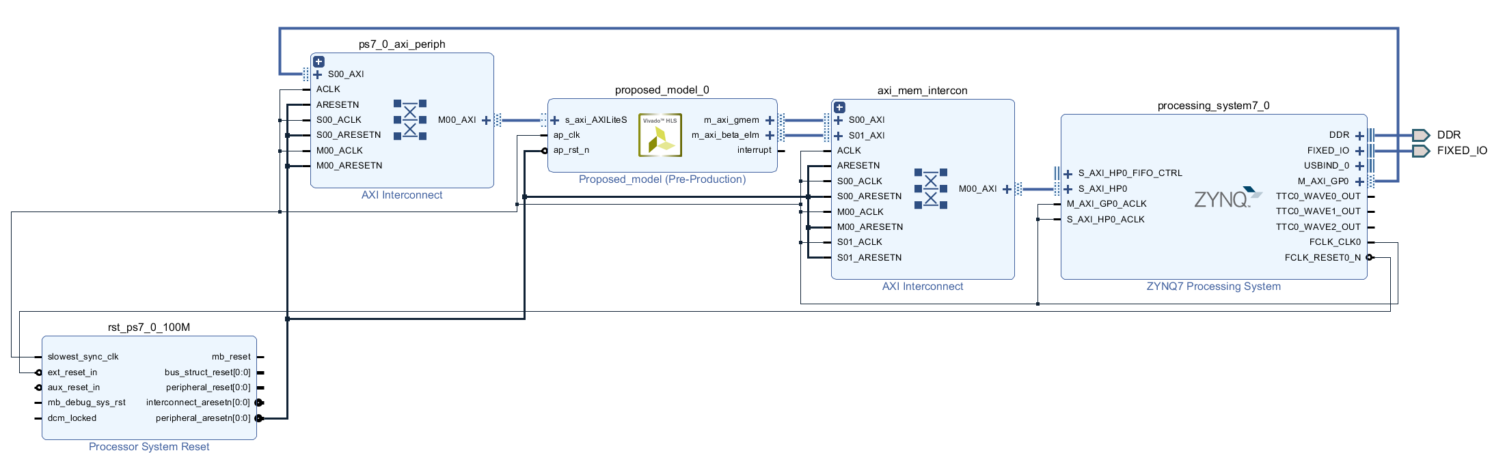
Implementation
Block design
Python on Host Program
HLS csim
Test
Re-Test
Throughput : 39 images/s
Notes:
(Wilbur)
IP and waveform

Slide 14
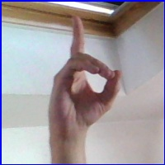
Conclusions
Algorithm
Accuracy on unbalance data: 88.75%
Accuracy after re-train: 92.07%
Implementation
QRD-ELM using Cordic to implement inverse matrix
Using the pragma to reduce the latency
Future Works
Real-time applications
Extend the dataset to motion gestures
Hand gestures seen from different angles recognition
Alphabet: D
Notes:
(Wilbur)
Our contributions and future work

